Slide 1



HEALTH INFORMATON TECHNOLOGY
AREA OF IT INVOLVING THE DESIGN,CREATION,DEVELOPMENT,USE AND MAINTENANCE OF INFORMATION SYSTEMS

Slide 2




Health IT (health information technology) is the area of IT involving the design, development, creation, use and maintenance of information systems for the healthcare industry. Automated and interoperable healthcare information systems will continue to improve medical care and public health, lower costs, increase efficiency, reduce errors and improve patient satisfaction, while also optimizing reimbursement for ambulatory and inpatient healthcare providers
DESIGN: CREATION: EARLY DETECTION:
How is technology used in healthcare?
It can help in early detection of health problems. It can also help in integrating data collected from tests instantly, monitor the condition of the patient, and then relay that information to the doctors and staff in real time, thereby improving the efficiency of the overall healthcare system.

Slide 3
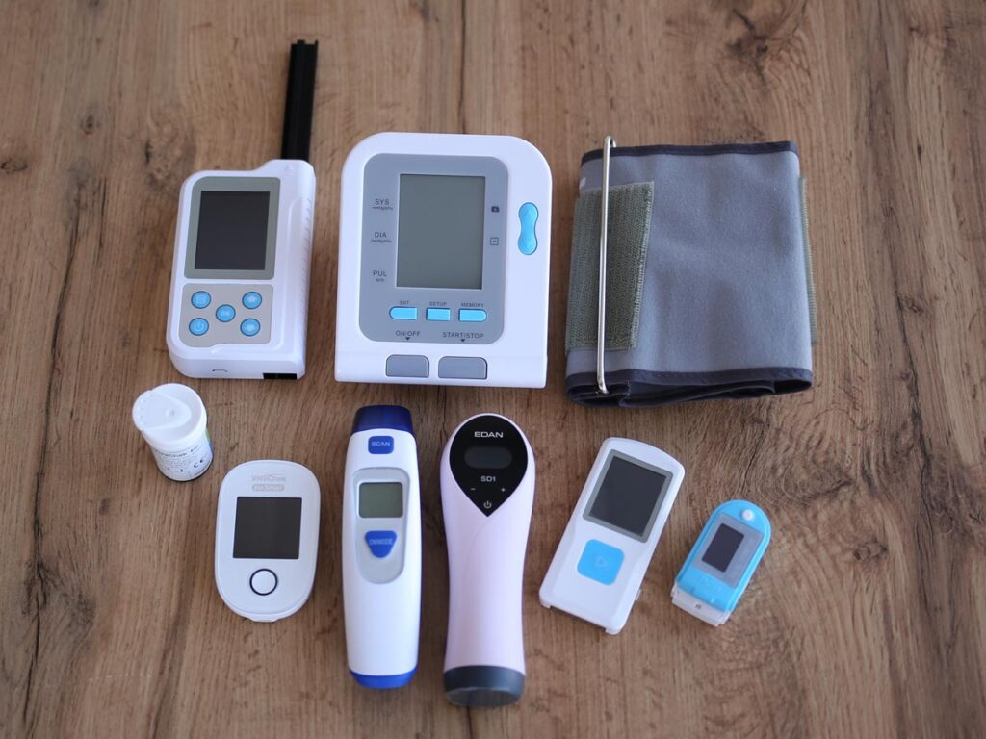
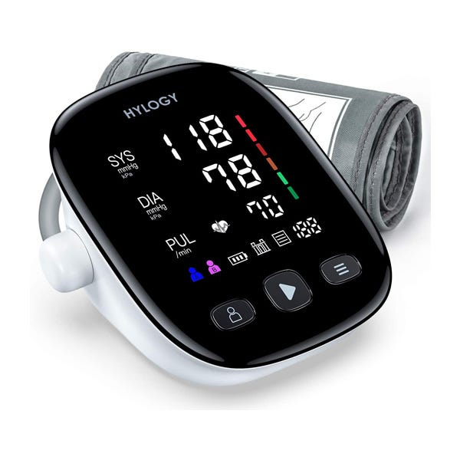


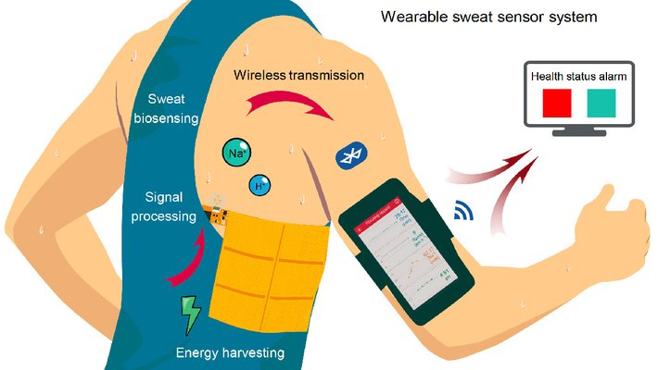
Role of Information Technology in the Hospitality Industry
Health information technology is all about communication between devices, between team members, between patients and their medical providers, between separate medical facilities.
IT services provider can help your facility initiate best practices for network security. Today’s patients expect their data to be secure, and we can help establish your reputation as a trustworthy steward of patient data
Remote monitoring tools
To improve the overall health of the population by improving the quality of care that patients receive.
Technological advancements in healthcare that have emerged over the last ten years.
Remote monitoring tools.
Sensor and wearable technology.
Wireless communication.
Sensors and wearable technology
Wireless communication
The electronic health record
mHealth.
Telehealth.
Wireless communication

Slide 4
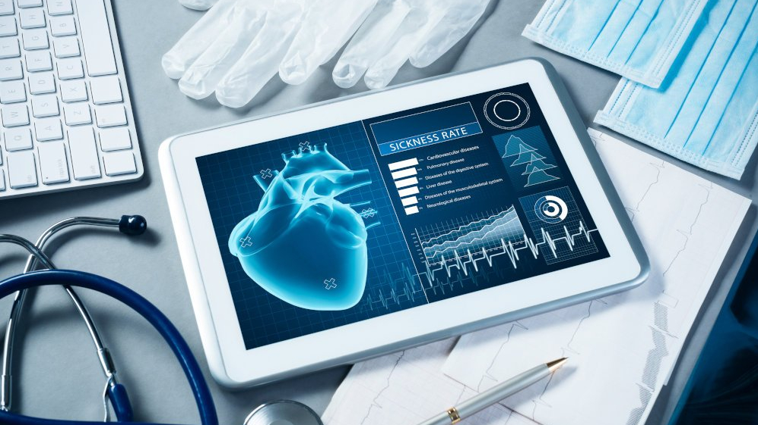
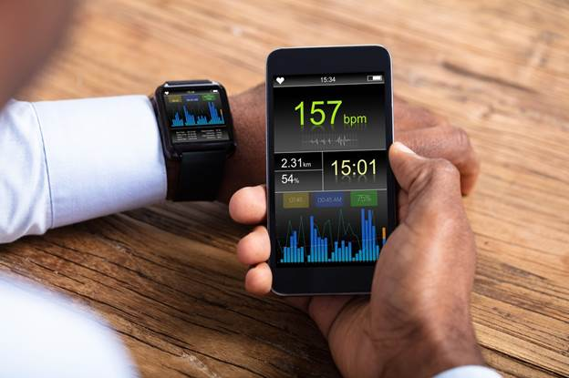
ELECTRONIC HEALTH RECORD:
An Electronic Health Record (EHR) is an electronic version of a patients medical history, that is maintained by the provider over time, and may include all of the key administrative clinical data relevant to that persons health.
M HEALTH:
Abbreviation for mobile health, a term used for the practice of medicine and public health supported by mobile devices. The term is most commonly used in reference to using mobile communication devices, such as mobile phones, tablet computers and wearable devices such as smart watches

Slide 5

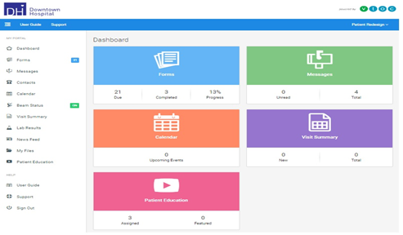
TELE HEALTH:
Telehealth is the use of communication technologies
to provide health care from a distance. Some examples of telehealth include: A "virtual visit" with a health care provider, through a phone call or video chat.
PATIENT PORTAL:
A patient portal is a secure online website that gives patients convenient, 24-hour access to personal health information from anywhere with an Internet connection. Using a secure username and password, patients can view health information

Slide 6
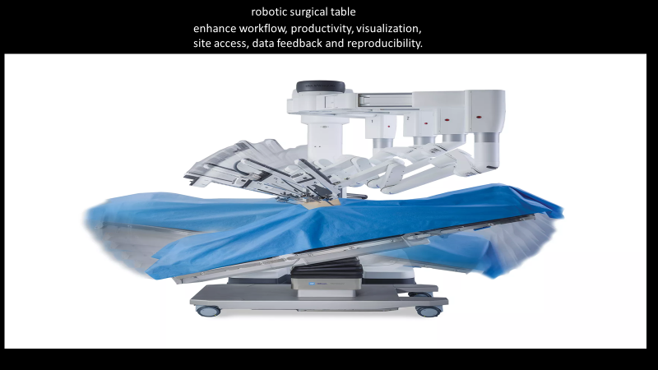
RECENT TECHNOLOGIES :

Slide 7
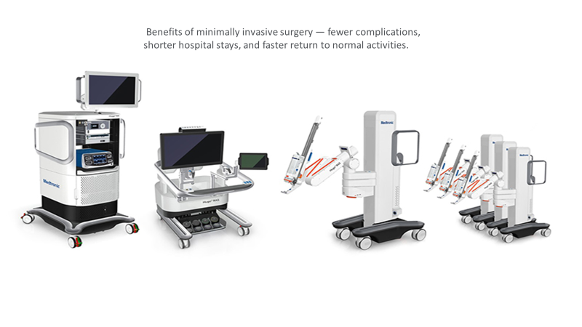
HUGO ROBOTIC SURGICAL SYSTEM:

Slide 8
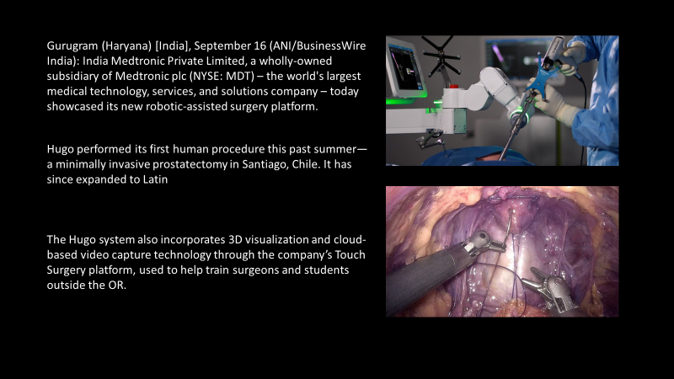

Slide 9
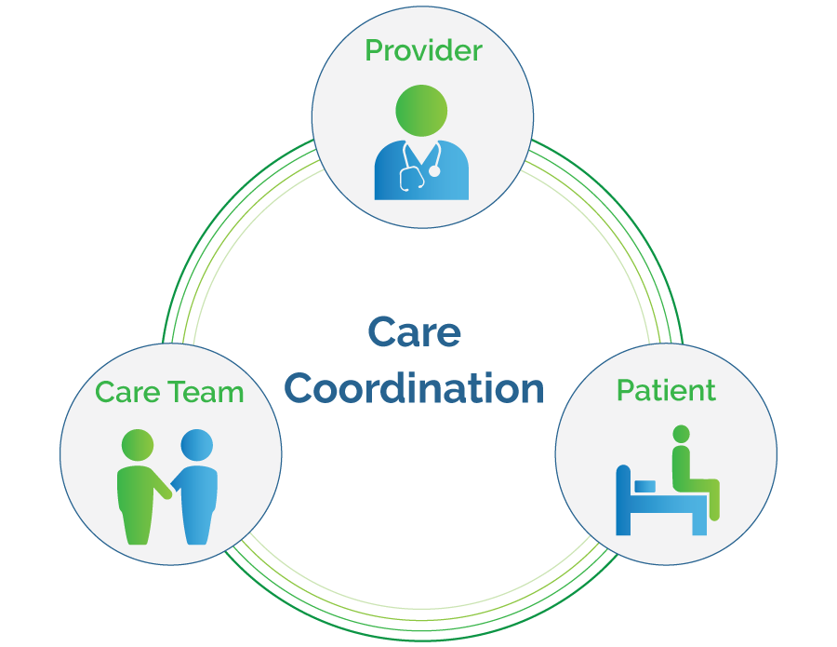


ADVANTAGES AND BENEFITS OF IT IN HEALTH CARE
Health information technology presents numerous opportunities for improving and transforming healthcare which includes; reducing human errors, improving clinical outcomes, facilitating care coordination, improving practice efficiencies, and tracking data over time.
Improved Care Coordination. ...
Improved Population Health Management. ...
Improved Patient Education.

Slide 10


